Slide 1
Gas Price Analysis
By Two Gassy Girls
Kimberly Kang & Phoebe Miao
June 6th, Monday 2022

Slide 2

Overview
Our Gas Price Analysis project uses Python, ETL, Web Scraping, and Machine Learning Model to explore the future Gas Price in the U.S. We performed price forecasting and prediction to visualize our findings based on the gas consumption, supply, and gas types in the last two decades. Our goal is to provide users to predict the future gas price in U.S. by interacting with various Machine Learning Models.

Slide 3
Timeline
 |  |  |  | May | June
Data finding & Data Cleaning
Machine Learning Model
Web Scraping & Visualization -> our Platform
RECORDING

Slide 4
Project objective:
Analyze Gas Price data from the past and find the best regression model to predict gas prices for the future

Slide 5
Proposed deliverables
Deliverable 1
Presentation
Deliverable 2
Database
Deliverable 3
Machine Learning Model
Deliverable 4
Our platform

Slide 6
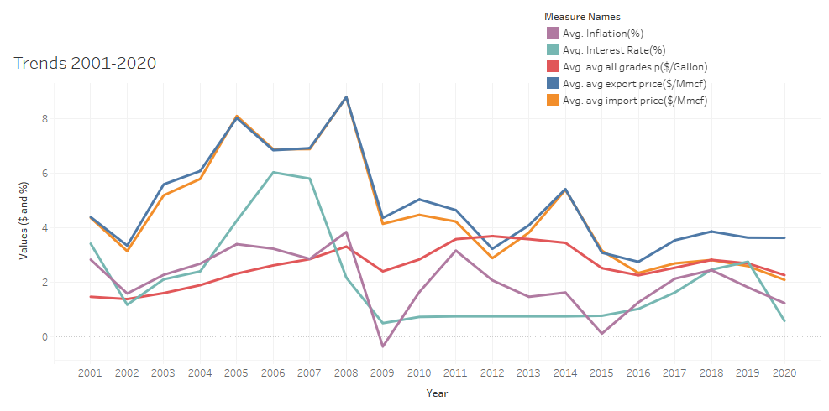
Trend among these 5 variables :
Tableau Dashboard
35
25
22
15

Slide 7
Understanding the Gas Price:
Imports & Exports
Supply, Demand & Storage
Natural Gas $ by Types
U.S. Natural Gas Total Imports vs. Total Exports
U.S. Natural Gas Import Prices vs. Export Prices
U.S. Marketed Natural Gas Production
U.S. Total Natural Gas Consumption
U.S. Natural Gas in Storage from Underground
All Grades all formulations Retail
Regular all formulations Retail
Midgrade all formulations Retail
Premium all formulations Retail
No.2 Diesel Retail
Reference: https://www.eia.gov/dnav/ng/ng_sum_lsum_dcu_nus_m.htm <- Very helpful website!

Slide 8
More Interesting Factors :
Us (we, us)
Money related
Electric Cars
Working population (Age 15-64)
Stock market capitalization to GDP (%)
Inflation (%)
Interest Rate (%)
Any time series data for Electric cars
Reference: https://fred.stlouisfed.org/categories/32267

Slide 9
Supervised Machine Learning Models
Multi-Linear Regression

Slide 10
Target audience
Our target audience can be…
ANYONE!
We made our platform to make sure people would be able to find the information on the forecasted U.S. gas price so conveniently

Slide 11
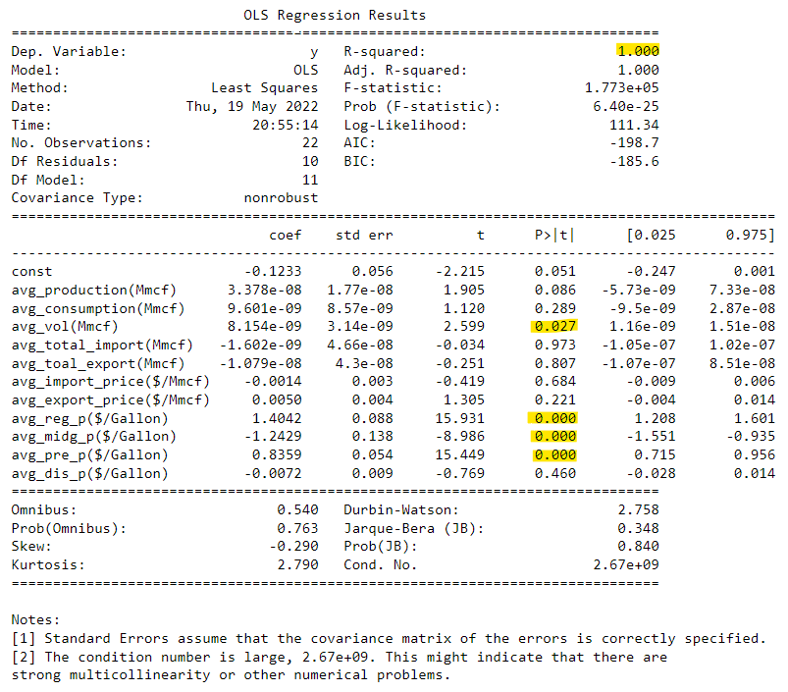
Statistical Results from Linear Regression (with 11 factors)
Findings from these regression results:
Our R-squared value is 1.0 which means that this model is perfectly fit. = 100% of the variability of our dependent variables is explained using this Linear Regression Model.
Significance level is 0.05 and our p-value for Avg Storage Volume, Avg Regular Price, Avg Premium Price, and Avg Diesel Price are less than 0.05 which indicates that these 4 variables are considered to be statistically significant

Slide 12
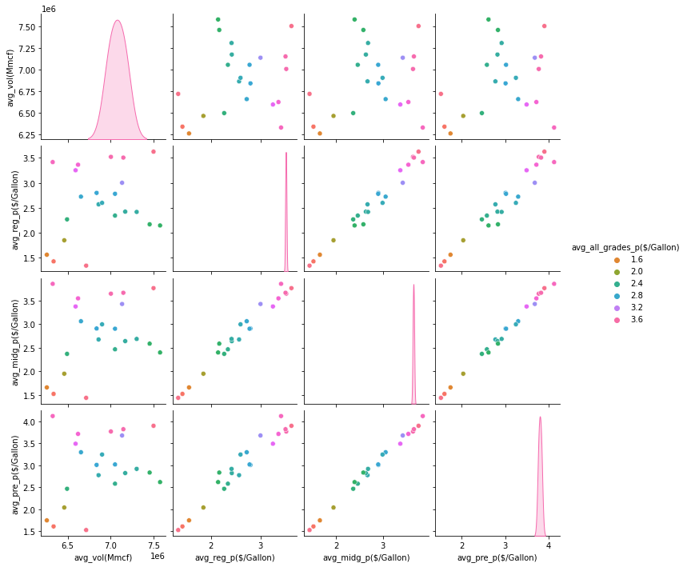
Visualize trends with 4 significant variables

Slide 13
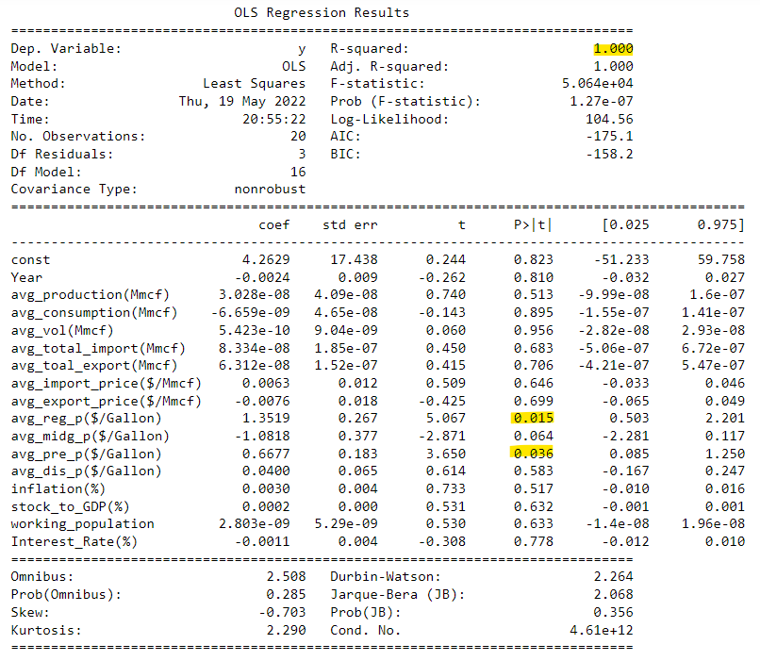
Statistical Results from Linear Regression (with 16 factors)
Findings from these regression results:

Slide 14
Our Best Linear Regression Model
Multi-linear Equation :

Slide 15
Our Platform to search Future Gas Price:
35
25
22
15

Slide 16


The Team - Two Gassy Girls
Phoebe Miao
Kimberly Kang
A full-time mom and a full-time worker worked on this project together when there were so many difficulties! We learned a lot together and now we feel like we have a good understanding of Data Analytics and we are ready to move onto the next step :)

